Slide 1
Recruitment Video Storyboard Template
How to use this storyboard template:
Creating a storyboard and a script is one of the most important—and time consuming—parts of the video creation process. A storyboard is an outline of your recruitment video to help you plan out your images and narration. This storyboard was developed by the Compare-UF study and has been edited into a template to help study teams organize their recruitment video planning.
Here’s how to use the template:
Images: Each slide shows suggested imagery and headlines. You can add your own images and details related to your study in the PowerPoint.
Script: Each slide has an accompanying section of script in the notes section of the PowerPoint. Each slide contains information on what to include, the context for how it’s used in the script, and an example of how it’s used in the Compare-UF script. On Slide 2, you can view the entire Compare-UF Script.
Notes:
How to use this storyboard template:
Creating a storyboard and a script is one of the most important—and time consuming—parts of the video creation process. This storyboard was used to create a recruitment video for the Compare-UF study and has been developed into a template to help study teams organize their recruitment video planning. Here’s how to use the template:
Images: Each slide shows suggested imagery and headlines. You can add your own images and details related to your study in the PowerPoint.
Script: Each slide has an accompanying section of script in the notes section of the PowerPoint. Each script section contains information on what to include, the context for how it’s used in the script, and an example of how it’s used in the Compare-UF script.
On Slide 2, you can view the entire Compare-UF Script.

Slide 2
Example: COMPARE-UF study recruitment video
Right click on image (open hyperlink) or use link below to watch
Script available below in notes
COMPARE-UF recruitment video link: https://ucsf.app.box.com/s/yl9yjz99hji3aluo0rwqagb5djezeo7d
Notes:
COMPARE UF Script:
COMPARE-UF is a study that will enroll 5,000 women currently seeking treatment for uterine fibroids at study sites all across the country.
Did you know that about 75% of women have fibroids and, they can really impact your health and daily life. Even though fibroids are common, there is a lot of important information that we still don’t know.
For instance,
Will my fibroids grow back after treatment?
Will this treatment impact my ability to have a safe pregnancy?
Which treatment has the fewest complications and risks?
COMPARE will help answer these questions and more!
COMPARE-UF is a unique type of research study called “patient-centered” research. Women with fibroids have been involved in all stages of planning COMPARE. The goal of this study is to be sure that we get answers about fibroids that are most important to you!
You may be eligible to enroll in COMPARE if you are:
Age 18-54
Still get a menstrual period
Scheduled for fibroid treatment
There are a few other criteria that a study coordinator can explain to you.
If you agree to participate in COMPARE, you will be asked to answer questionnaires about your fibroid symptoms: before your treatment; six weeks after your treatment; and then once a year thereafter.
Enrolling is easy and can be done either in person, online, or in the mail!
Participants that complete all of the study procedures may receive up to $80 in gift cards.
If you or someone you know if planning fibroid treatment, we want to hear from you! Please consider joining COMPARE!
[END]

Slide 3
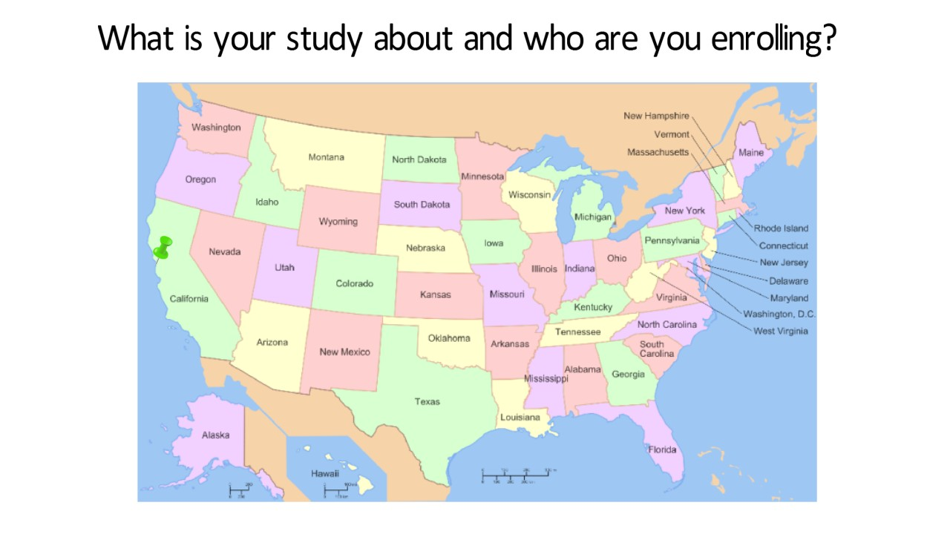
What is your study about?
What to include: Use this section to describe what your study is about, and who you are looking for.
Who are you targeting for enrollment (men, women, children, or people with a particular diagnosis or condition)
How many people you expect to enroll?
Narration: [Insert study name] is a study that will enroll X number of participants [address them as men/women/children if possible and/or appropriate] that are undergoing [or that have a particular diagnosis for a particular condition]
Notes:
What to include: Use this section to describe what your study is, and who you are looking for.
Who are you targeting for enrollment (men, women, children, or people with a particular diagnosis or condition)
How many people you expect to enroll
How it’s used in the script: [Insert study name] is a study that will enroll X number of participants [address them as men/women/children if possible and/or appropriate] that are undergoing [or that have a particular diagnosis for a particular condition] …
Example from COMPARE video: COMPARE-UF is a study that will enroll 5,000 women currently seeking treatment for uterine fibroids at study sites all across the country.

Slide 4
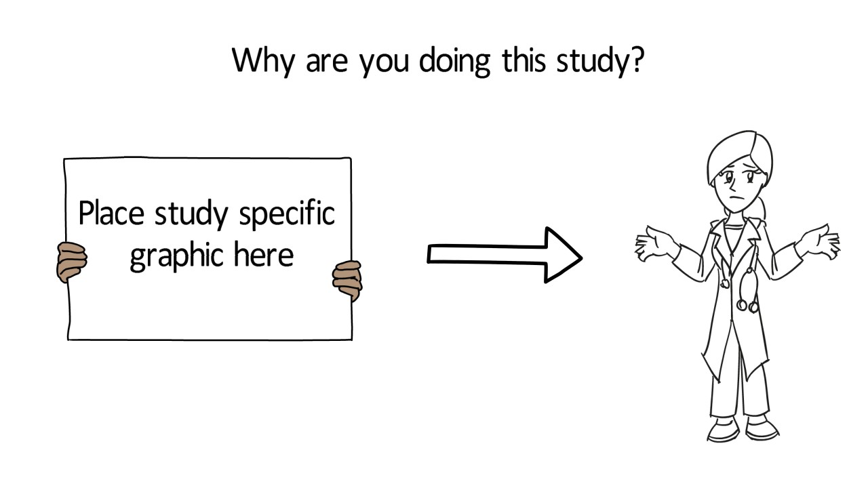
Why are you doing this study?
What to include: Use this section to explain why you’re doing the study, what you hope to accomplish with this study, and why participants would want to join. This section may be divided into several slides.
Are there any relevant statistics or facts that would be worth mentioning?
Tie this into why your study is important and being done
Narration: [Discuss why study is important- list any interesting statistics if applicable].
Notes:
Why are you doing this study? Research aims? Goals? (2-3 sentences MAX )
What to include: Use this section to explain why you’re doing the study, what you hope to accomplish with this study, and why participants would want to join. This section may be divided into several slides.
What are the reason (s) your study is being done?
Research aims
Are there any relevant statistics or facts that would be worth mentioning?
Tie this into why your study is important and being done
What is the ultimate goal of your study?
How it’s used in the script: [Insert study name] is a study looking to [insert research aims]. [Insert reason for study]. [Discuss why study is important- list any interesting statistics if applicable]. With your participation we may be able to [insert ultimate goal of the study].
Example from COMPARE video:
[slide 1]
Did you know that about 75% of women have fibroids and, they can really impact your health and daily life. Even though fibroids are common, there is a lot of important information that we still don’t know. [PAUSE]
[slide 2]
For instance, Will my fibroids grow back after treatment? Will this treatment impact my ability to have a safe pregnancy? Which treatment has the fewest complications and risks? COMPARE will help answer these questions and more!
[slide 3]
COMPARE-UF is a unique type of research study called “patient-centered” research. Women with fibroids have been involved in all stages of planning COMPARE. The goal of this study is to be sure that we get answers about fibroids that are most important to you!

Slide 5
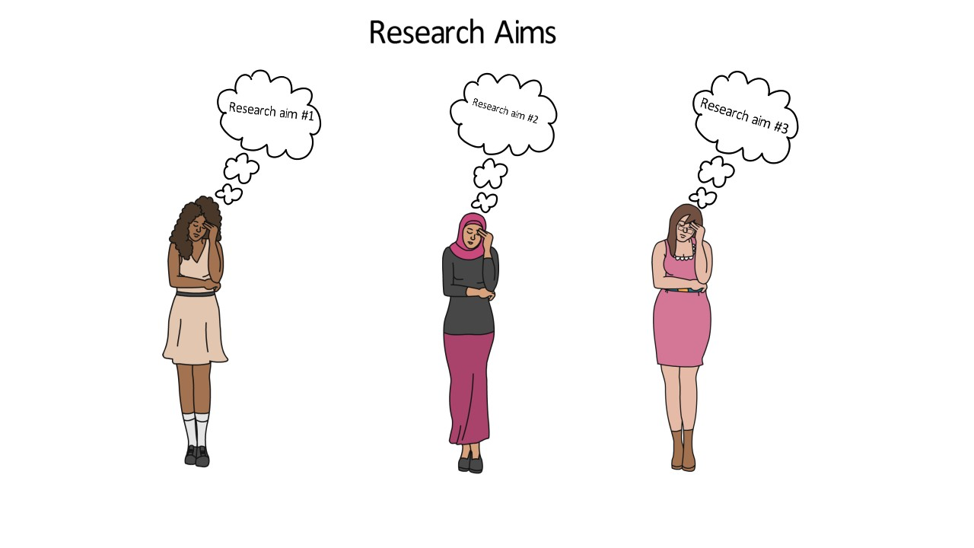
Research Aims
What are the reason (s) your study is being done?
Research aims
Narration: [Insert study name] is a study looking to [insert research aims].
Notes:
(See notes on slide 4)

Slide 6
What is the ultimate goal of your study?
Narration: With your participation, we may be able to [insert ultimate goal of the study].
Notes:
(See notes on slide 4)

Slide 7
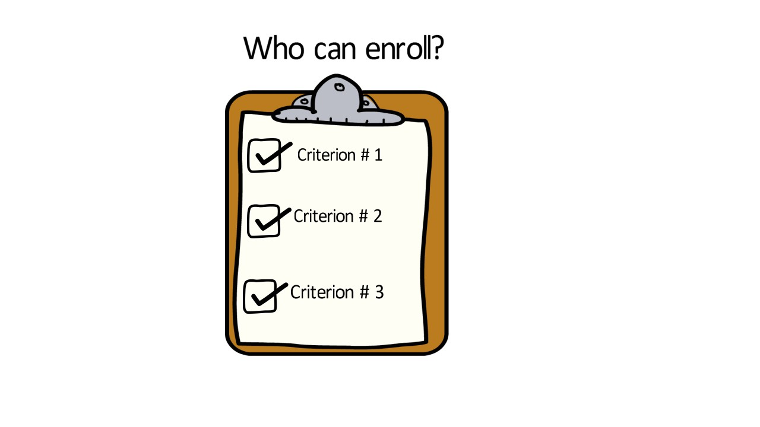
Eligibility Criteria
Narration: You may be eligible to enroll in [study name] if you are: Criterion # 1; Criterion # 2; Criterion # 3
There are a few other criteria that a study coordinator can explain to you.
Notes:
Eligibility Criteria:
What to include: Use this section to go over basic eligibility criteria for the study. If there are several criterions for eligibility (typically addressed in a telephone screener), highlight the top three and note that a coordinator can explain the rest.
How it’s used in the script: You may be eligible to enroll in [insert study name] if you are:
Criterion # 1
Criterion # 2
Criterion # 3
There are a few other criteria that a study coordinator can explain to you.
Example from COMPARE video: You may be eligible to enroll in COMPARE if you are:
Age 18-54
Still get a menstrual period
Scheduled for fibroid treatment
There are a few other criteria that a study coordinator can explain to you.

Slide 8
Narration: If you agree to participate in [insert study name], you will be asked to answer questionnaires every X number of months about XYZ. Optional: These surveys will take approximately x amount of minutes to complete. --OR— If you agree to participate in [insert study name], you will be asked to come to our offices for X number of in-person visits at [list location and frequency of visits] and do X,Y, and Z. Optional: These visits should take x amount of time.
Notes:
Study Activities (~ 1-2 sentences)
What to include: Use this section to highlight what a participant is expected to do if enrolled in the study.
Make sure to note frequency of visits, are the visits online or in person?
If answering questionnaires, what kind of questions (generally) will they be answering?
Also note how long these activities take to complete, i.e. are the visits typically an hour long? Do the surveys typically take x amount of minutes to complete?
How it’s used in the script: If you agree to participate in [insert study name], you will be asked to answer questionnaires every X number of months about XYZ. Optional: These surveys will take approximately x amount of minutes to complete.
--OR—
How it’s used in the script: If you agree to participate in [insert study name], you will be asked to come to our offices for X number of in-person visits at [list location and frequency of visits] and do X,Y, and Z. Optional: These visits should take x amount of time.
Example from COMPARE video: If you agree to participate in COMPARE, you will be asked to answer questionnaires about your fibroid symptoms: before your treatment; six weeks after your treatment; and then once a year thereafter.

Slide 9
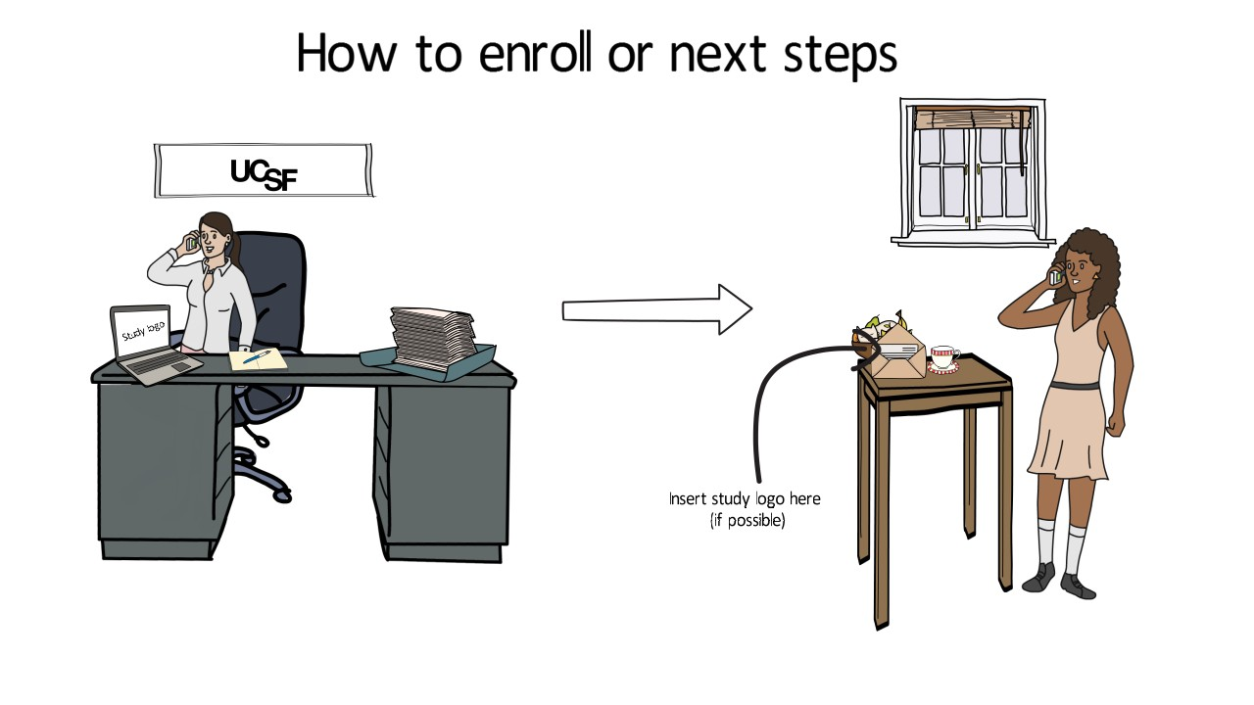
How does a participant enroll in your study?
Narration: Enrolling is easy and can be done: Enrollment method 1; Enrollment method 2; Enrollment method 3 --OR--To enroll in [study name], we’ll have to schedule an in-person visit and do X,Y,Z…
Notes:
How to enroll or next steps (one sentence)
What to include: Use this section to explain how interested participants can enroll in the study. Note content may vary depending on what kinds of activities and/or criterions are required for participants to be considered an enrolled participant. I.e. some studies may require a survey be filled out by a particular deadline; others may require an in-person screening and/or baseline office visit.
If they need to fill out a survey note how/where these surveys can be completed: online? In person? Via mail? All of the above?
If enrollment involves coming in for an in-person clinic visit, note how many visits are required to enroll; what will they be doing at these screening/baseline visits?
How it’s used in the script: Enrolling is easy and can be done:
Enrollment method 1
Enrollment method 2
Enrollment method 3
--OR--
How it’s used in the script: To enroll in [study name], we’ll have to schedule an in-person visit and do X,Y,Z…
Example from the COMPARE video: Enrolling is easy and can be done either in person, online, or in the mail!

Slide 10
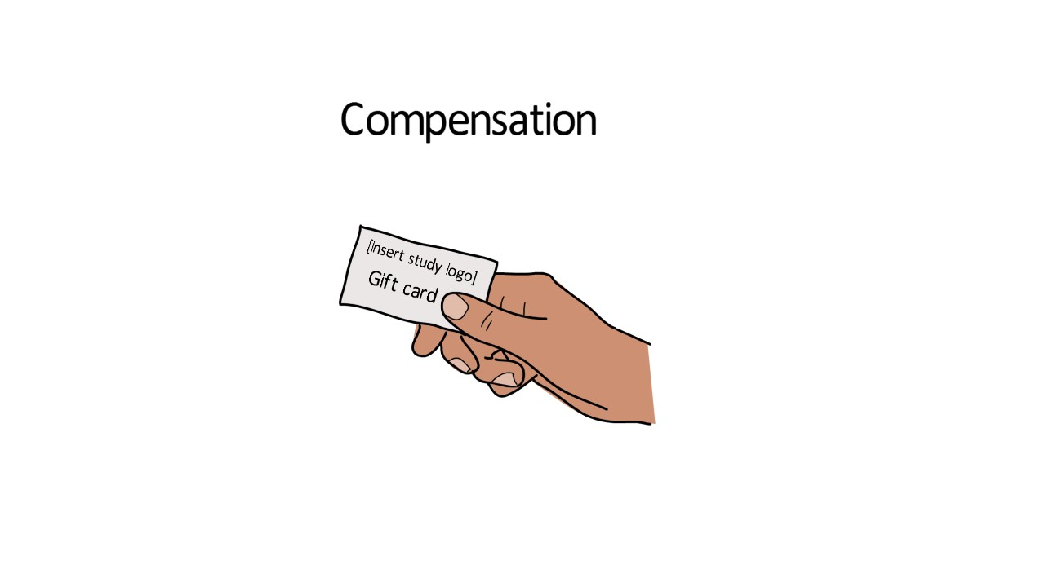
Narration: Participants that complete all of the study procedures (or attend all study visits) may receive up to $XX in [method of payment].
Notes:
Compensation
What to include: Use this section to note the total compensation given to participants in the study.
Note the method of payment you’ll be using: gift cards? checks? cash?
How it’s used in the script: Participants that complete all of the study procedures (or attend all study visits) may receive up to $XX in [method of payment].
Example from the COMPARE video: Participants that complete all of the study procedures may receive up to $80 in gift cards.

Slide 11
Contact Information
Narration: If you or someone you know is affected by x condition or doing x type of treatment/procedure, we want to hear from you! Please consider joining [study name]
Notes:
Contact Information
What to include: Use this section to note how interested participants can contact the study team.
Provide a study specific e-mail address (https://recruit.ucsf.edu/quick-tips-recruitment#Create-a-UCSF-study-email) and phone number for participants to contact.
If applicable, share you study’s website and/or social media page (Facebook, Twitter, etc..)
How it’s used in the script: If you or someone you know is affected by x condition or doing x type of treatment/procedure, we want to hear from you! Please consider joining [study name]
Example from the COMPARE video: If you or someone you know if planning fibroid treatment, we want to hear from you! Please consider joining COMPARE!

